Slide 1
Welsh Learning Platform
Graphic user interface

Slide 2
Ideal users
John is an English student who wishes to learn Welsh
He is not studying the language professionally
He is using this platform in order to memorize all the Welsh words.
LEARNING PLATFORM
Jennifer works in a Welsh company and is taking Welsh courses
She already knows some of the language, but she wants to practice more
PRACTICING PLATFORM
FFion is Welsh student who is proficient in Welsh, but not completely
She still needs to look up in the dictionary sometimes
DICTIONARY

Slide 3
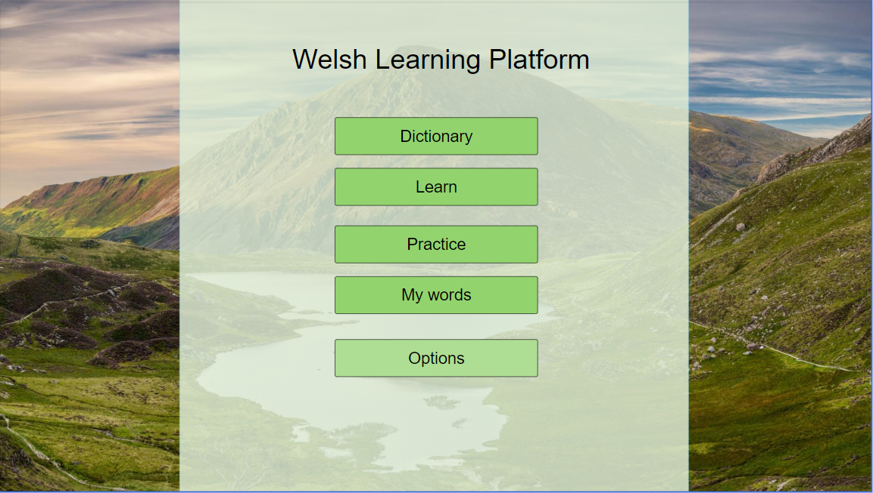

Slide 4
Main Menu
5 simple buttons
Dictionary
Learn
Practice
My words
Options

Slide 5
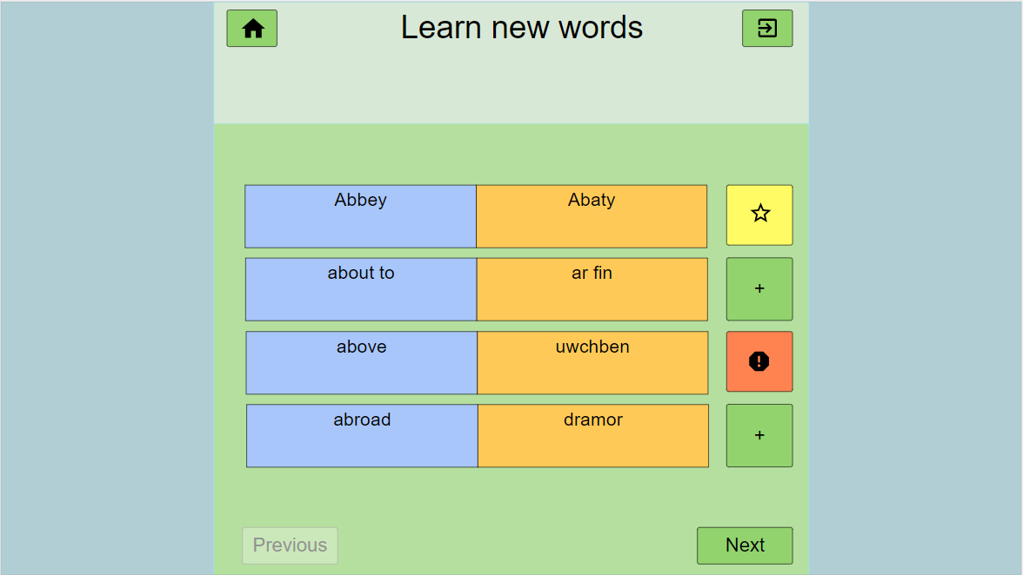
Learn

Slide 6
Learn
Home button
Exit button
Random (or ordered) list of words
4 each screen in this layout
Buttons to save a word in a list
Or mark it as “difficult word”
Next and previous group of words

Slide 7
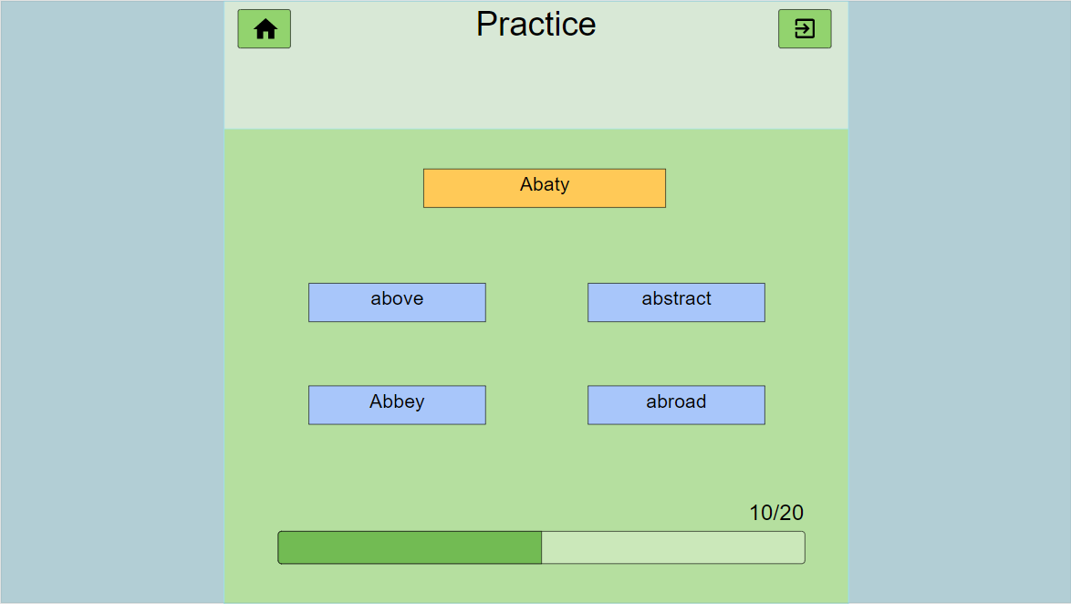
Practice

Slide 8
Practice
Word to guess
Possible solutions
Progress bar

Slide 9
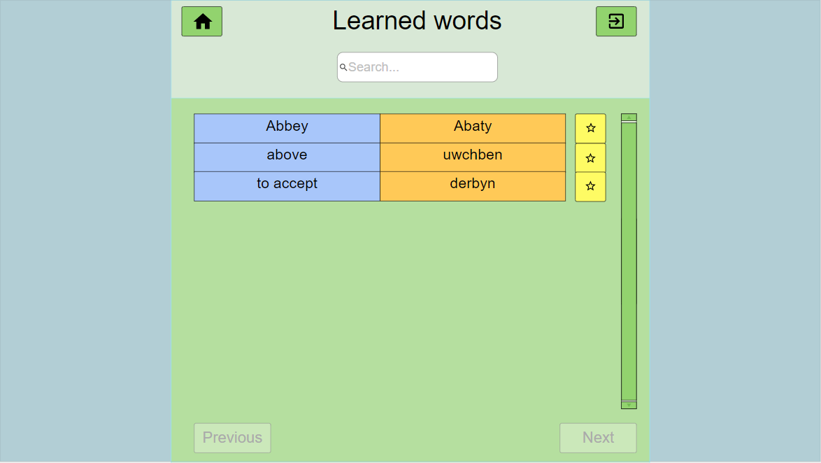
My words
Search bar (when the list is big enough)
List of words
Click to
remove
from list
Scrolling bar
(when list is big)

Slide 10
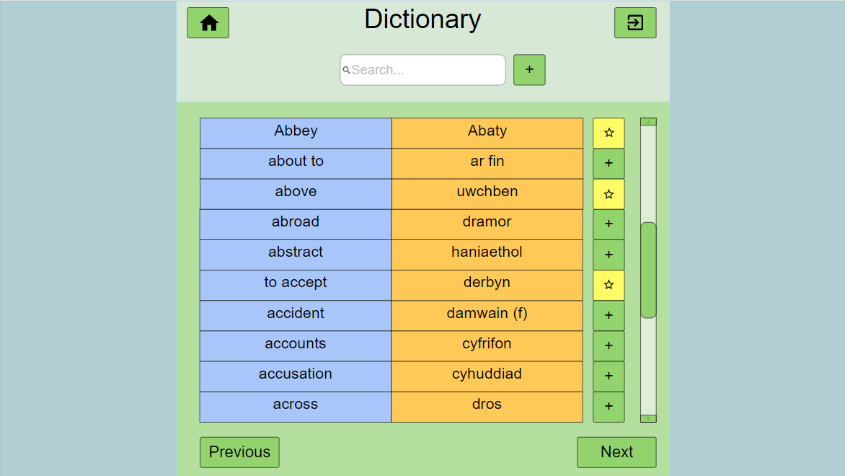
Dictionary
Add new word
In dictionary if
Doesn’t exist yet
Insert word
In “words to learn”

Slide 11
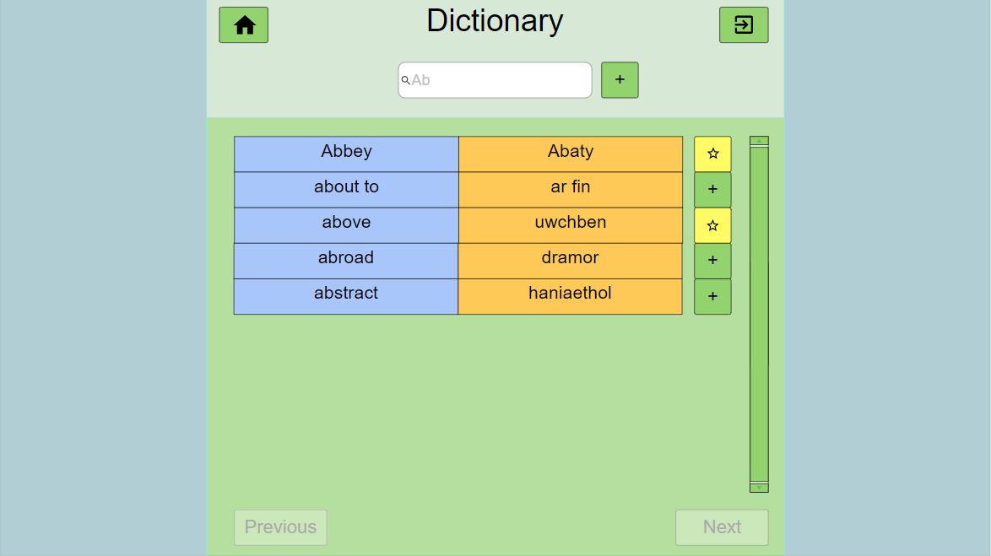
Dictionary
Example: searching a word that begins with “ab”

Slide 12
DOCUMENT HISTORY
Version | CCF No. | Date | Changes made to this document | Changed by
1.0 | N/A | 5/02/2020 | First release | fec11

